Slide 1

On Becoming a Leader in Risk Management
Fundamentals of RM
RM System and Process
Leadership in RM
Incident Investigation
RM Tools & Challenges
RM in Industry
People & Org.
Application and Perspectives
ENGG404
Chapter 5.7: A Multi-Layered Approach to Hazard / Risk Assessment
1
Notes:
ENGG404 Lecture 00 - Day 1
2012 Fall
1
1

Slide 2
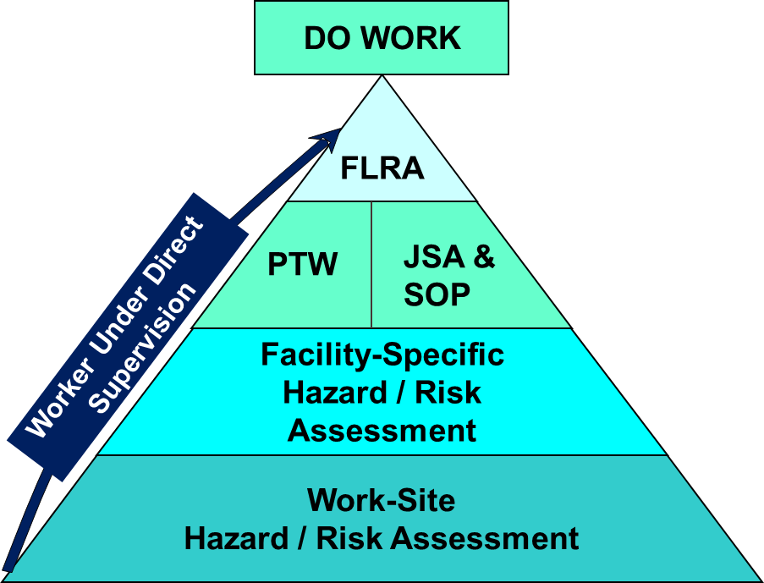
Recall Chapter 5.1: Tools for Risk Management
Let’s examine the integration and systematic use of these tools …
FLRAs
SQRAs
CCOHS JSAs
Checklists
Planned Inspections & Audits
Chapter 5.7: Multilayered Approach to Hazard Assessment
2

Slide 3
Introduction:
All risk assessment tools we are discussing (FLRA, SQRA, JSA, etc.) fundamentally follow the same approach.
Activity description
Hazard and risk identification
Control measures
A multilayered approach allows the workers to build up layers of hazard and risk information.
Exceeds requirements of the AB OH&S Code Part 2.
Think about the kind or type of “safety training” you had, particularly on the first day of work or first day at a new location, or first day of a new job.
Chapter 5.7: Multilayered Approach to Hazard Assessment
3
Notes:
3

Slide 4
Six Steps in the Multi-layered Approach:
Consider a typical indoctrination before a person can do work in a workplace:
Receive Work-site Hazard / Risk Assessment.
Receive Facility-specific Hazard / Risk Assessment.
Prepared with Job Safety Analysis (or Safe Operating Procedure or Safe Maintenance Procedure).
Receive Authorization To Proceed With Work.
i.e. Permit to Work
Complete FLRA
Do Work.
Have you ever experienced or used one or more of these layers in your workplace?
Show of hands as each one is called out.
Chapter 5.7: Multilayered Approach to Hazard Assessment
4
Notes:
4

Slide 5

Application in Industry:
Consider a new engineer at a construction company:
Company “On-board” training
Work-site specific safety training
Facility specific lab testing training
Job specific training on how to crush samples of cured concrete (JSA)
Task-specific SOP for using the crushing test equipment
Permits to use the equipment (PTW)
FLRA just prior to crushing cured concrete samples
Proceed to do the work!
Chapter 5.7: Multilayered Approach to Hazard Assessment
5
Notes:
5

Slide 6
In Summary:
All risk assessment tools we are discussing (FLRA, SQRA, JSA, etc.) fundamentally follow the same approach.
Activity description
Hazard and risk identification
Control measures
A multilayered approach allows the workers to build up layers of hazard and risk information.
Applies to all workers at the work-site.
Recall your ESG K.P. #2 Understand your program! The Multi-layered approach is a small part of the overall program, and will aid you in understanding that for which you are responsible.
Chapter 5.7: Multilayered Approach to Hazard Assessment
6
Notes:
6

Slide 7
On Becoming a Leader in Risk Management
Fundamentals of RM
RM System and Process
Leadership in RM
Incident Investigation
RM Tools & Challenges
RM in Industry
People & Org.
Application and Perspectives
ENGG404
Chapter 5.8: Job Observations and Planned Inspections (Audits)
7
Notes:
7

Slide 8
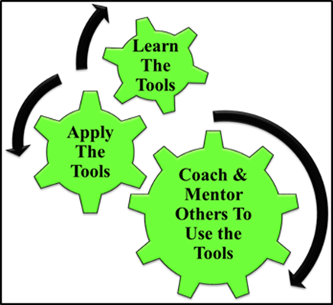
Learning Outcomes:
Apply JO & PI Method to create a Planned Inspection Checklist.
Apply JO & PI Checklist to use, interpret, critique, and check the compliance of physical conditions in the work-place or the practices of work-in-progress.
Apply JO & PI Method as a rudimentary skill of leadership to observe, interact, check, commend, or intervene / coach employees in the work-place i.e. at the individual level or the team (crew, work-group) level.
A leader’s job ... coach and mentor!
Chapter 5.8: Job Observations and Planned Inspections
8
Notes:
8

Slide 9
Risk Management Tools:
FLRAs
SQRAs
CCOHS JSAs
Checklists
Planned Inspections & Audits
Chapter 5.1: Tools for Risk Management
9

Slide 10
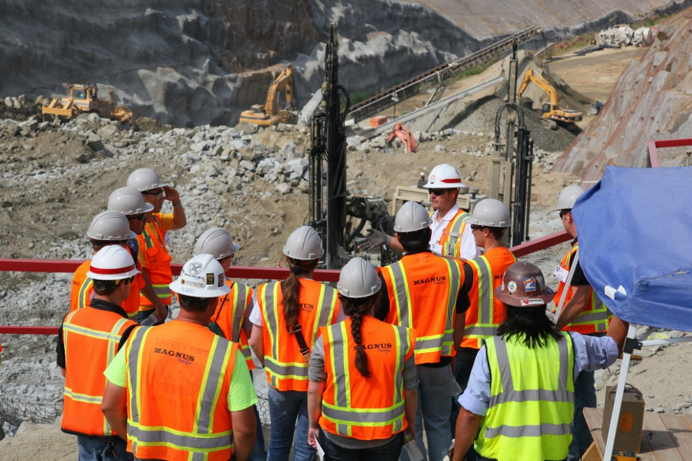
Why Do We Do Job Observations and Planned Inspections?
As part of orientation and integration activities for new employees and contractors
To ensure our admin procedures are adequate (ensure not too confusing, too long, appropriate for the work task
For training purposes (& combatting complacency)
Chapter 5.8: Job Observations and Planned Inspections
10
Notes:
10

Slide 11
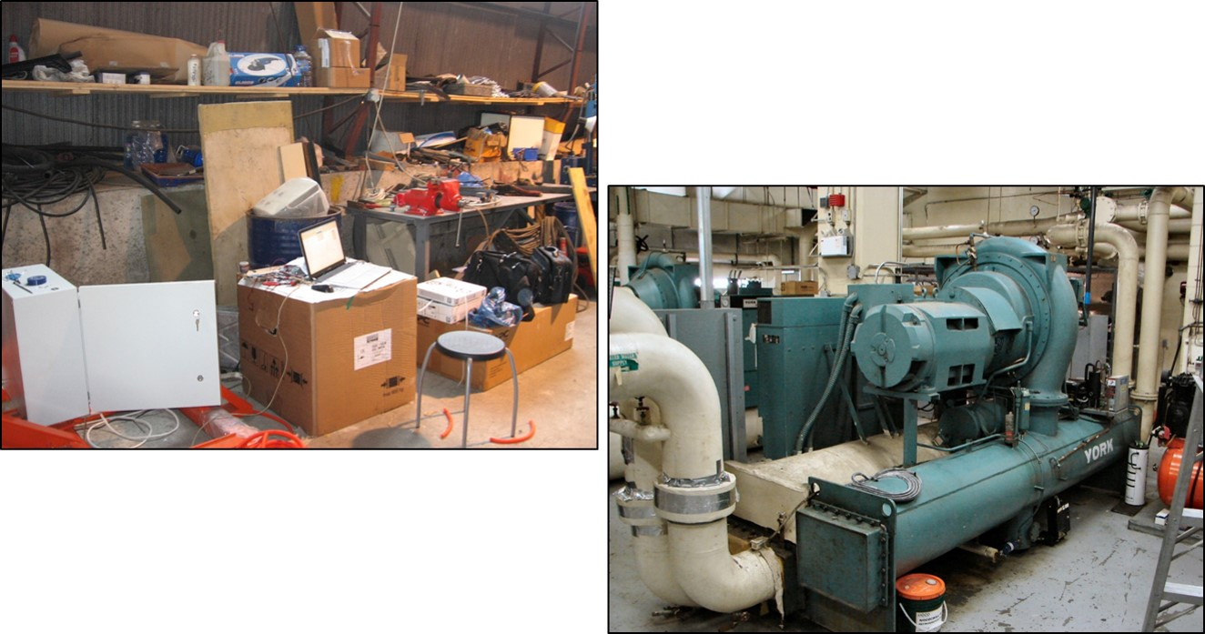
Introduction:
Two different kinds of a Planned inspection:
Physical conditions in the workplace
Practices of work-in-progress
Chapter 5.8: Job Observations and Planned Inspections
11
Notes:
11

Slide 12



Introduction:
Two different kinds of a Planned inspection:
Physical conditions in the workplace
Practices of work-in-progress (to observe, interact, check)
At the Individual Level (the manager and the worker) or
At the Team Level (the manager and a team i.e. a crew or shift or group of workers).
Chapter 5.8: Job Observations and Planned Inspections
12
Notes:
12

Slide 13
Purpose of JO & PI at the Individual / Team Level:
The purposes of job observations and planned inspections:
Observe workers,
Interact with workers,
Check for compliance i.e. sub-standard conditions or sub-standard practices?
Act on their findings:
If compliant, commend the workers.
If non-compliant, intervene (act, take steps to address)
The above management actions:
Reinforce the expected conditions and practices.
Combat complacency in the workplace.
Chapter 5.8: Job Observations and Planned Inspections
13
Notes:
13

Slide 14
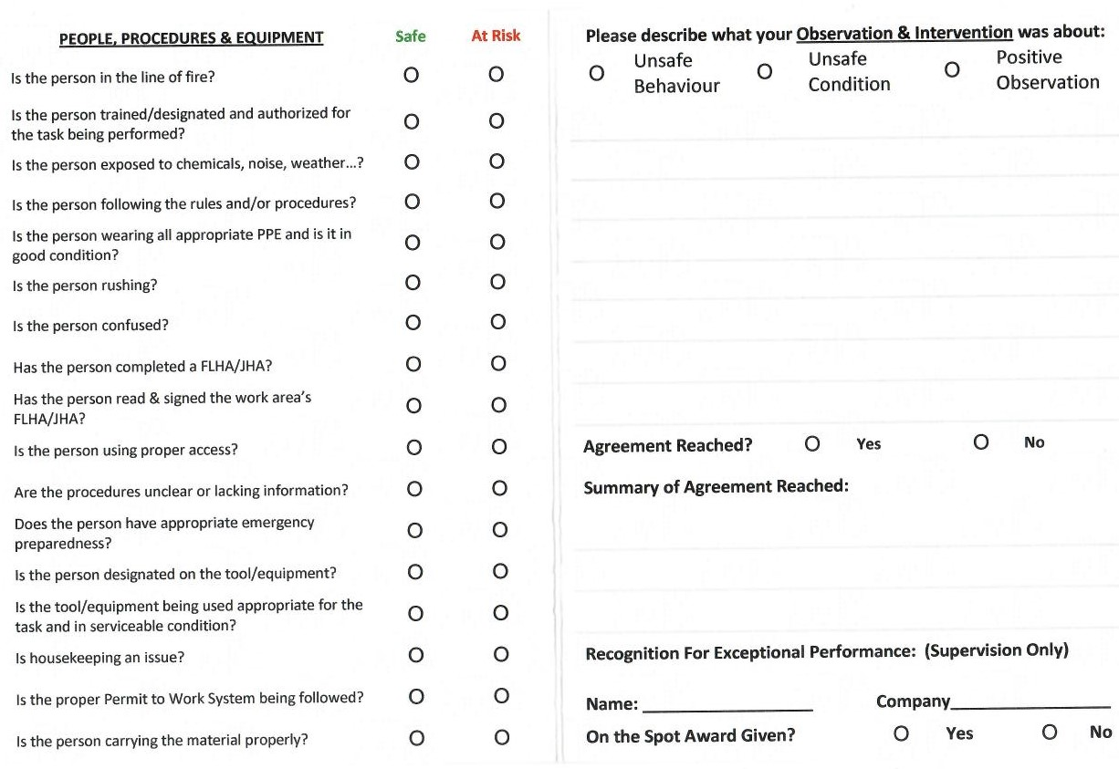
Job Observation/Planned Inspection Card
14
Notes:
14

Slide 15
The Means of JO & PI at the Individual / Team Level:
Expertise in these four skills:
Required to know the work area, some knowledge of the trade, nature of the work, and requirements.
Managers need to observe.
Need to have social skills
Be able to “ask open-ended questions”
… ensures that managers:
Will be successful in their interactions with workers and
Reinforce the expected practices and conditions, and
Maintain management visibility, and
Combat complacency in the workplace.
Chapter 5.8: Job Observations and Planned Inspections
15
Notes:
15

Slide 16
JO & PI as a Means to Combat Complacency:
Complacency – the acceptance of SCs and SPs in the workplace
Complacency sets in when:
Workers become accustomed to and comfortable with the operations, facility, equipment, procedures, and work processes.
This comfort level leads to complacency.
The workers may begin to take “short-cuts” with practices and/or conditions.
The manager can – and must – combat complacency:
Planned inspections check for compliance AND act to correct deviations.
Face-to-face coaching to be empowered to address sub-standard conditions and at-risk behaviours …
Positively influence safety culture of the organization.
16
Notes:
16

Slide 17

Summary and Key Lesson:
Planned inspections are a means for:
Checking for conditions and practices
An opportunity for management visibility and engaging workers
Combating complacency.
Combatting complacency IS one way to positively influence safety culture of the organization.
We must engage workers and we must value the conversation with workers about their practices.
Managers need skills to “talk with people”! These skills are essential successful leadership in risk management.
Chapter 5.8: Job Observations and Planned Inspections
17
Notes:
17

